Slide 1
Analog and Digital Electronic Lab Subject Code:18csl37
Realize a J-K Master / Slave Flip-Flop using NAND gates and verify its truth table. and implement the same in HDL.

Slide 2
Introduction
A flip flop is an electronic circuit with two stable states that can be used to store binary data.
Flip-flops and latches are fundamental building blocks of digital electronics systems used in computers, communications, and many other types of systems.
Flip-flops and latches are used as data storage elements

Slide 3
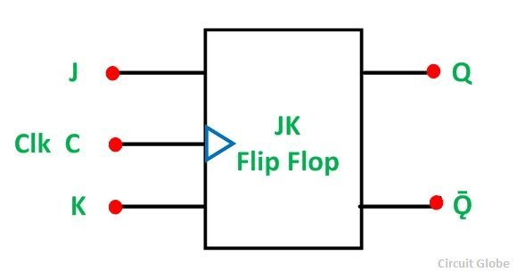
J-K Flip-Flop
The JK Flip Flop is the most widely used flip flop. It is considered to be a universal flip-flop circuit. The sequential operation of the JK Flip Flop is the same as for the RS flip-flop with the same SET and RESET input.
The JK Flip Flop name has been kept on the inventor name of the circuit known as Jack Kilby.

Slide 4
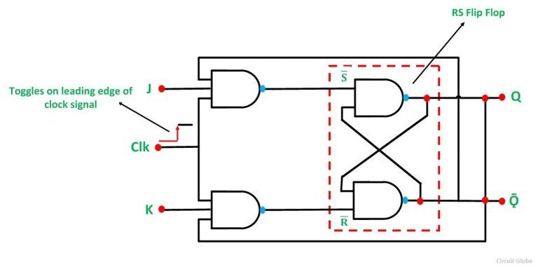
J-K Flip-Flop

Slide 5
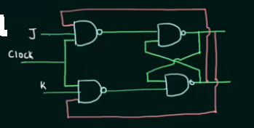
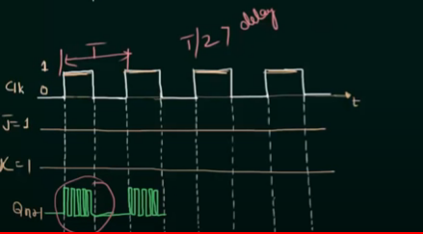
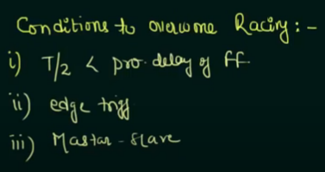
J-K Flip-Flop→ Race Around Condition
Racing is because of feedback connection

Slide 6
J-K Flip-Flop
Race Around Condition
In JK Flip-flop – For J-K flip-flop, if J=K=1, and if clk=1 for a long period of time, then Q output will racing as long as CLK is high, which makes the output of the flip-flop unstable or uncertain. This problem is called race around condition in J-K flip-flop. This problem (Race Around Condition) can be avoided by ensuring that the clock input is at logic “1” only for a very short time. This introduced the concept of Master Slave JK flip flop.
Racing is uncontrolled phenomenal whereas toggling is controlled phenomenal

Slide 7
THEORY
It does the same function as JK flip-flop with the difference that Master Slave units are pulse triggered ones rather than edge triggered ones. The Master Slave JK flipflop consists of flip-flop’s one a master and the other a slave .
the clock input is given to the master and the clock’ is given to the slave such that when the clock is high master is enabled and the slave is disabled and the output of the master is at steady state.
when the clock goes low the clock’ is high and the master is disabled while slave is enabled now the output of the master reaches the slave output there by overcoming the race around problem

Slide 8
DESCRIPTION
A JK master flip flop is positive edge triggered, where as slave is negative edge triggered. Therefore master first responds to J and K inputs and then slave.
If J=0 and K=1, master resets on arrival of positive clock edge. High output of the master drives the K input of the slave. For the trailing edge of the clock pulse the slave is forced to reset.
If both the inputs are high, it changes the state or toggles on the arrival of the positive clock edge and the slave toggles on the negative clock edge. The slave does exactly what the master does.

Slide 9
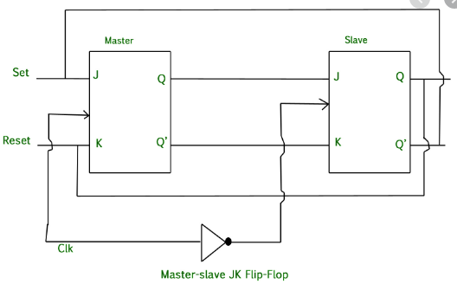
Master-slave J K flip-flop

Slide 10
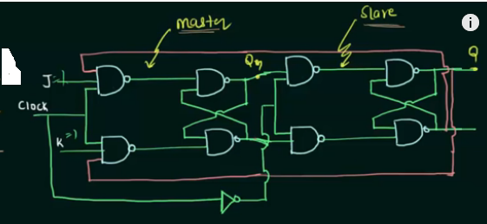
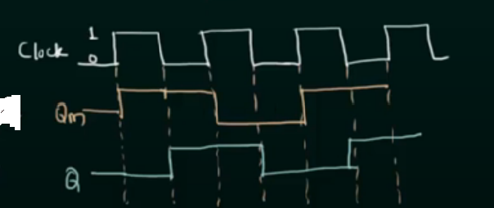
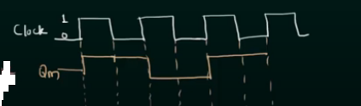
Master-slave J K flip-flop

Slide 11
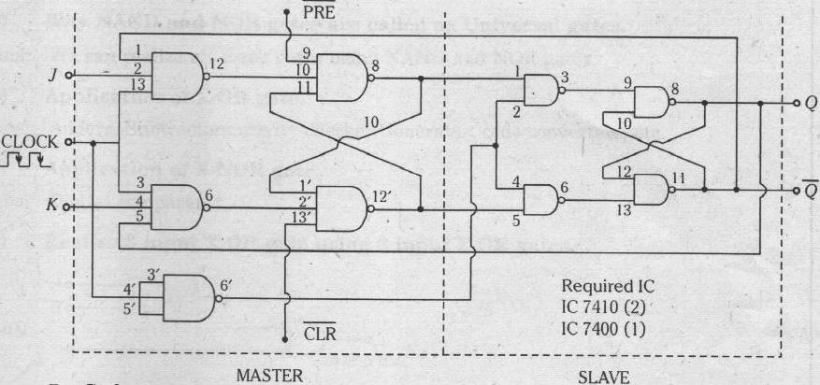
Master-slave J K flip-flop

Slide 12
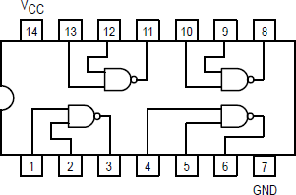
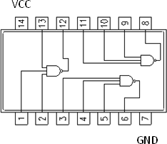
Master-slave J K flip-flop
COMPONENTS REQUIRED: IC7410, IC7400, patch chords, trainer kit
PIN DIAGRAMS
IC 7410 – 3 INPUT NAND GATE
2 INPUT NAND Gate 74LS00

Slide 13
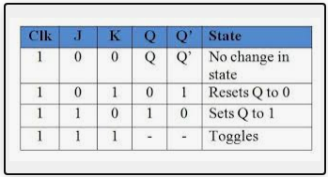
J-K Flip-Flop Truth Table

Slide 14
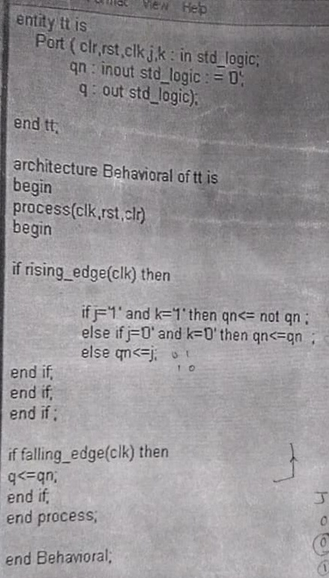
VHDL Code for Master-Slave Flip-Flop

Slide 15
Analog and Digital Electronic Lab Subject Code:18csl37
Design and implement an asynchronous counter using decade counter IC to count up from 0 to n (n<=9) and demonstrate on 7-segment display (using IC- 7447).

Slide 16
THEORY
A decade counter is a binary counter that is designed to count to 1010 (decimal 10).
Asynchronous counter is a counter in which the clock signal is connected to the clock input of only first stage flip flop. The clock input of the second stage flip flop is triggered by the output of the first stage flip flop and so on. This introduces an inherent propagation delay time through a flip flop. A transition of input clock pulse and a transition of the output of a flip flop can never occur exactly at the same time. Therefore, the two flip flops are never simultaneously triggered, which results in asynchronous counter operation.

Slide 17
THEORY
The 74LS90, is 4-bit ripple type Decade Counter. It consists of four master/slave flip- flops
A gated AND asynchronous Master Reset (MR1 MR2) is provided on all counters which overrides and clocks and resets (clears) all the flip-flops. A gated AND asynchronous Master Set (MS1 MS2) is provided on the LS90 which overrides the clocks and the MR inputs and sets the outputs to nine (HLLH)

Slide 18
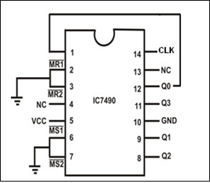
Logic Diagram of Decade counter

Slide 19
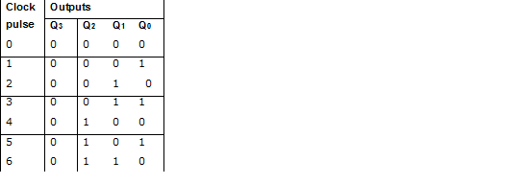
PROCEDURE
When clock pulses are applied, the desired count sequence is observed on output pins Q3, Q2, Q1, and Q0 as illustrated in the truth table
For connecting Mod-7 disconnect the ground terminal of MR1 & MR2 and then connect into the o\p terminal of AND gate.

Slide 20
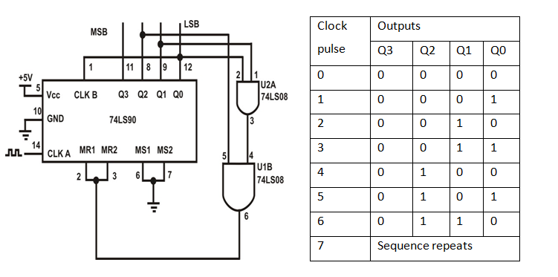
Logic Diagram of MOD-7 Counter

Slide 21
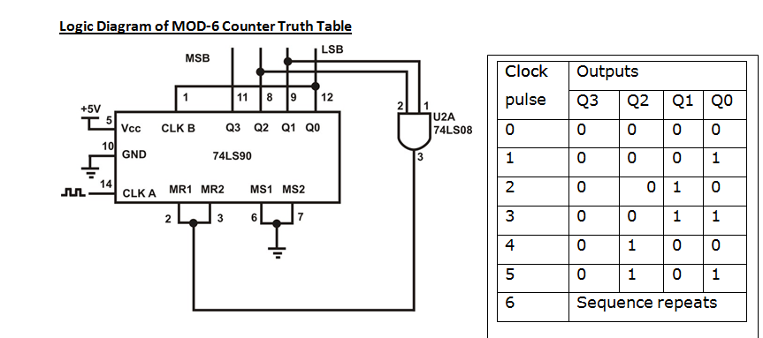
Logic Diagram of MOD-6 Counter

Slide 22
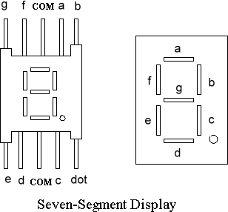
BCD TO 7-SEGMENT DECODER
A decoder is a combinational circuit that connects the binary information from ‘n’ input lines to a maximum of 2n unique output lines. The IC7447 is a BCD to 7-segment pattern converter. The IC7447 takes the Binary Coded Decimal (BCD) as the input and outputs the relevant 7 segment code.

Slide 23
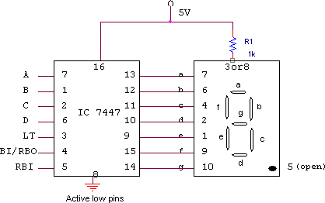
CIRCUIT DIAGRAM:

Slide 24
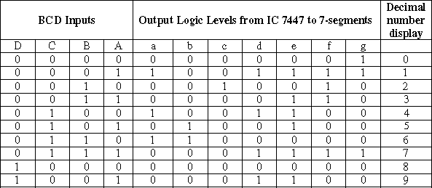
TRUTH TABLE

Slide 25
Thank you

